Slide 1
Datalink layer

Slide 2
Datalink layer:
In the osi model, the data link layer is a 4th layer from the top and 2nd layer from the bottom.
The data link layer is responsible for the node-to-node delivery of the message. The main function of this layer is to make sure data transfer is error-free from one node to another, over the physical layer. When a packet arrives in a network, it is the responsibility of DLL to transmit it to the Host using its MAC address. Data Link Layer is divided into two sublayers:
Logical Link Control (LLC)
Media Access Control (MAC)
The packet received from the Network layer is further divided into frames depending on the frame size of NIC(Network Interface Card). DLL also encapsulates Sender and Receiver’s MAC address in the header.
The Receiver’s MAC address is obtained by placing an ARP(Address Resolution Protocol) request onto the wire asking “Who has that IP address?” and the destination host will reply with its MAC address.

Slide 3
Function of Datalink layer
Framing
Physical addressing
Error control
Flow control
Access control

Slide 4
Framing:
The data link layer receives the stream of bits from the network layer divides into manageable data units called frames.
Physical addressing:
After creating frames, the Data link layer adds physical addresses (MAC address) of the sender and/or receiver in the header of each frame.
Error control:
Data link layer provides the mechanism of error control in which it detects and retransmits damaged or lost frames.
Flow Control:
The data rate must be constant on both sides else the data may get corrupted thus, flow control coordinates the amount of data that can be sent before receiving acknowledgement.
Access control:
When a single communication channel is shared by multiple devices, the MAC sub-layer of the data link layer helps to determine which device has control over the channel at a given time.

Slide 5
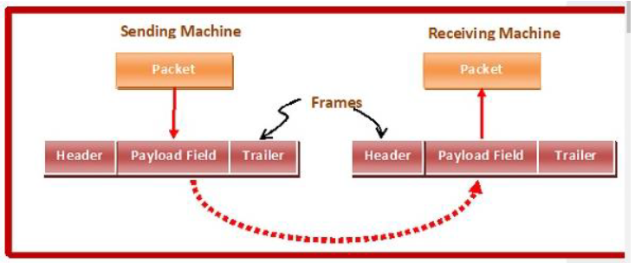
Framing:
In the physical layer, data transmission involves synchronized transmission of bits from the source to the destination.
The data link layer packs these bits into frames. Data-link layer takes the packets from the Network Layer and encapsulates them into frames.
If the frame size becomes too large, then the packet may be divided into small sized frames. Smaller sized frames make flow control and error control more efficient. Then, it sends each frame bit-by-bit on the hardware. At receiver’s end, data link layer picks up signals from hardware and assembles them into frames.

Slide 6

Parts of a Frame
A frame has the following parts −
Frame Header − It contains the source and the destination addresses of the frame.
Payload field − It contains the message to be delivered.
Trailer − It contains the error detection and error correction bits.
Flag − It marks the beginning and end of the frame.

Slide 7
Types of Framing
Framing can be of two types, fixed sized framing and variable sized framing.
Fixed-sized Framing :
Here the size of the frame is fixed and so the frame length acts as delimiter of the frame. Consequently, it does not require additional boundary bits to identify the start and end of the frame.
variable sized:
Here, the size of each frame to be transmitted may be different. So additional mechanisms are kept to mark the end of one frame and the beginning of the next frame.

Slide 8
Flow Control Mechanism:
Flow control coordinates the amount of data that can be sent before receiving an acknowledgment and is one of the most important duties of the data link layer.
When a data frame is sent from one host to another over a single medium, it is required that the sender and receiver should work at the same speed. That is, sender sends at a speed on which the receiver can process and accept the data. If sender is sending too fast, the receiver may be overloaded and data may be lost.

Slide 9
Two types of mechanisms can be deployed to control the flow:
stop and wait Protocol
Sliding Window Protocol
Simple Stop and Wait
This flow control mechanism forces the sender after transmitting a data frame to stop and wait until the acknowledgement of the data-frame sent is received. The sender sends the next frame only when it has received a positive acknowledgement from the receiver that it is available for further data processing.
One frame at a time.
It is simple as each frame is checked and acknowledged brfore the next frame.

Slide 10
Stop and Wait ARQ (Automatic Repeat Request)
The following transition may occur in Stop-and-Wait ARQ:
• The sender maintains a timeout counter.
• When a frame is sent, the sender starts the timeout counter.
• If acknowledgement of frame comes in time, the sender transmits the next frame in queue.
• If acknowledgement does not come in time, the sender assumes that either the frame or its acknowledgement is lost in transit. Sender retransmits the frame and starts the timeout counter.
• If a negative acknowledgement is received, the sender retransmits the frame.

Slide 11
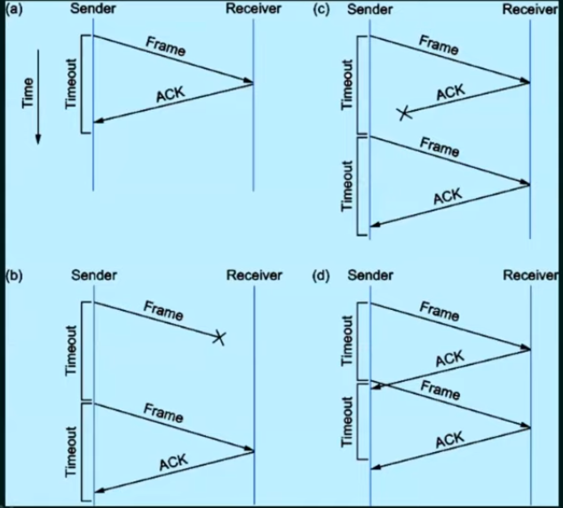

Slide 12
Sliding Window Protocol
Send multiple frames at a time
Each frame has a unique sequence number
The number of frame to be sent is based on window size.
The term sliding window refers to the imaginary boxes to hold frames.
Sliding window method is also known as windowing. In these protocols, the sender has a buffer called the sending window and the receiver has buffer called the receiving window.

Slide 13
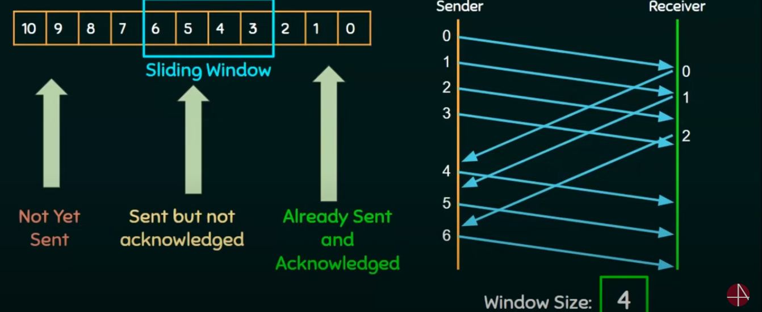

Slide 14
The types of sliding window protocol include:
A One Bit Sliding Window Protocol
A Protocol Using Go Back N
A Protocol Using Selective Repeat
A one bit sliding window protocol is work as the stop and wait protocol
A Protocol Using Go Back N
GO-Back-N ARQ uses the concept of protocol pipelining ie. Sender can send multiple frames before receiving the acknowledgement for the first frame.
There are finite number of frames and the frames are numbered in a sequential manner.
The number of frames that can be sent depends on the window size of the sender
If the acknowledgement of a frame is not received within an agreed upon time period, all frames in the current window are retransmitted

Slide 15
Working of Go-Back-N ARQ
Suppose there are a sender and a receiver, and let's assume that there are 11 frames to be sent. These frames are represented as 0,1,2,3,4,5,6,7,8,9,10, and these are the sequence numbers of the frames. Mainly, the sequence number is decided by the sender's window size. But, for the better understanding, we took the running sequence numbers, i.e., 0,1,2,3,4,5,6,7,8,9,10. Let's consider the window size as 4, which means that the four frames can be sent at a time before expecting the acknowledgment of the first frame.

Slide 16
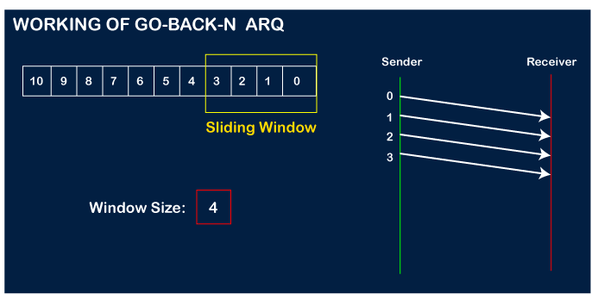
Step 1: Firstly, the sender will send the first four frames to the receiver, i.e., 0,1,2,3, and now the sender is expected to receive the acknowledgment of the 0th frame.

Slide 17
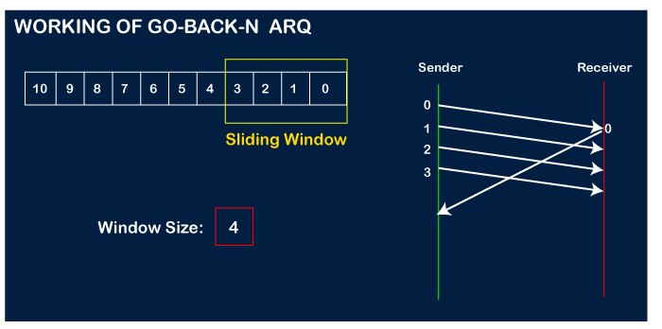
Let's assume that the receiver has sent the acknowledgment for the 0 frame, and the receiver has successfully received it.

Slide 18
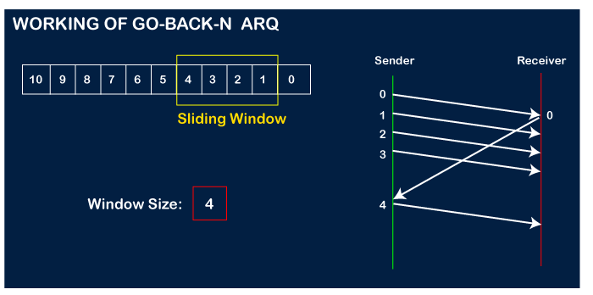
The sender will then send the next frame, i.e., 4, and the window slides containing four frames (1,2,3,4).

Slide 19
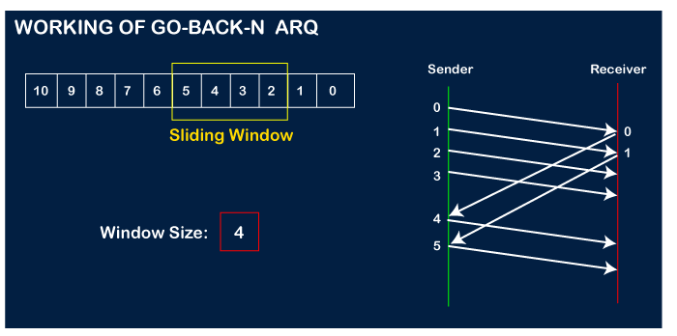
The receiver will then send the acknowledgment for the frame no 1. After receiving the acknowledgment, the sender will send the next frame, i.e., frame no 5, and the window will slide having four frames (2,3,4,5).

Slide 20
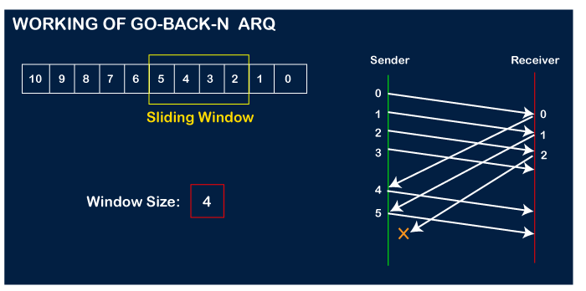
Now, let's assume that the receiver is not acknowledging the frame no 2, either the frame is lost, or the acknowledgment is lost. Instead of sending the frame no 6, the sender Go-Back to 2, which is the first frame of the current window, retransmits all the frames in the current window, i.e., 2,3,4,5.

Slide 21
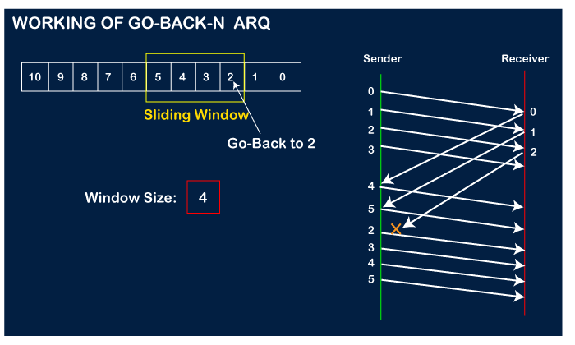

Slide 22
Important points related to Go-Back-N ARQ:
In Go-Back-N, N determines the sender's window size, and the size of the receiver's window is always 1.
It does not consider the corrupted frames and simply discards them.
It does not accept the frames which are out of order and discards them.
If the sender does not receive the acknowledgment, it leads to the retransmission of all the current window frames.

Slide 23
Source of Error:
Noise:
Electromagnetic Interference (EMI): External electromagnetic signals from nearby devices or sources can interfere with the transmitted signals.
Attenuation:
Signal Loss: As signals travel over a medium, they can weaken, leading to signal degradation and errors.
Distortion:
Signal Distortion: Changes in the shape or characteristics of the signal waveform during transmission can result in errors.
Crosstalk:
Near-End Crosstalk (NEXT) and Far-End Crosstalk (FEXT): Signals from adjacent channels or cables can interfere with each other, leading to errors.

Slide 24
Jitter:
Timing Variations: Variability in the timing of signal arrivals can lead to jitter, causing errors in data reception.
Interference from Electronic Devices: Other electronic devices operating in the vicinity can introduce interference.
Bit Errors:
Random Bit Flips: Unintentional changes in individual bits during transmission can occur due to various factors.

Slide 25
Temperature and Environmental Factors:
Temperature Changes: Variations in temperature can affect the characteristics of the transmission medium.
Humidity and Moisture: Water damage or high humidity levels can impact certain types of transmission media.
Faulty Equipment:
Malfunctioning Hardware: Issues with network interface cards (NICs), routers, switches, or other equipment can introduce errors.
Distance and Signal Quality:
Signal Attenuation with Distance: The quality of the signal may degrade over long distances, leading to errors.
Signal-to-Noise Ratio (SNR):
Low SNR: A low ratio of signal strength to background noise can result in errors.
Coding and Modulation Errors:
Inadequate Error Correction Codes: Errors may occur if the error correction codes used are not sufficient for the level of noise in the transmission.

Slide 26
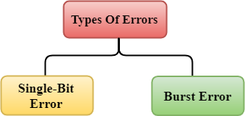
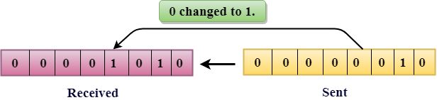
Error
When data is transmitted from one device to another device, the system does not guarantee whether the data received by the device is identical to the data transmitted by another device. An Error is a situation when the message received at the receiver end is not identical to the message transmitted.
Types Of Errors
Errors can be classified into two categories:
Single-Bit Error
Burst Error
Single-Bit Error:
The only one bit of a given data unit is changed from 1 to 0 or from 0 to 1.

Slide 27
In the above figure, the message which is sent is corrupted as single-bit, i.e., 0 bit is changed to 1.
Single-Bit Error does not appear more likely in Serial Data Transmission. For example, Sender sends the data at 10 Mbps, this means that the bit lasts only for 1 ?s and for a single-bit error to occurred, a noise must be more than 1 ?s.
Single-Bit Error mainly occurs in Parallel Data Transmission. For example, if eight wires are used to send the eight bits of a byte, if one of the wire is noisy, then single-bit is corrupted per byte.

Slide 28
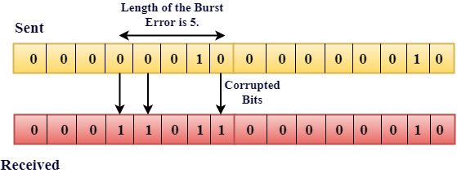
Burst Error:
The two or more bits are changed from 0 to 1 or from 1 to 0 is known as Burst Error.
The Burst Error is determined from the first corrupted bit to the last corrupted bit.

Slide 29
The duration of noise in Burst Error is more than the duration of noise in Single-Bit.
Burst Errors are most likely to occur in Serial Data Transmission.
The number of affected bits depends on the duration of the noise and data rate.
Error Detecting Techniques:
The most popular Error Detecting Techniques are:
Single parity check
Two-dimensional parity check
Checksum
Cyclic redundancy check

Slide 30
Single Parity Check
The parity check is done by adding an extra bit, called parity bit to the data to make a number of 1s either even in case of even parity or odd in case of odd parity.
While creating a frame, the sender counts the number of 1s in it and adds the parity bit in the following way
In case of even parity: If a number of 1s is even then parity bit value is 0. If the number of 1s is odd then parity bit value is 1.
In case of odd parity: If a number of 1s is odd then parity bit value is 0. If a number of 1s is even then parity bit value is 1.
On receiving a frame, the receiver counts the number of 1s in it. In case of even parity check, if the count of 1s is even, the frame is accepted, otherwise, it is rejected. A similar rule is adopted for odd parity check.
The parity check is suitable for single bit error detection only.

Slide 31
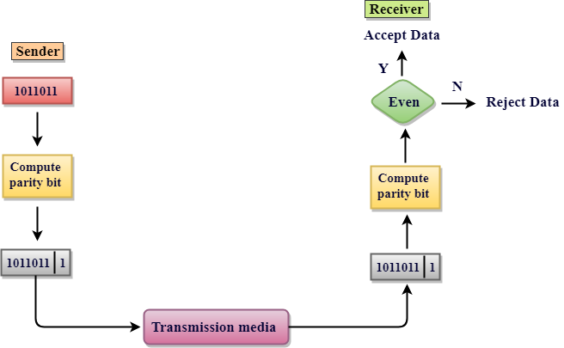

Slide 32
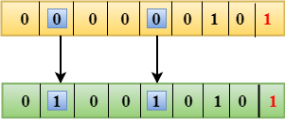
Drawbacks Of Single Parity Checking
It can only detect single-bit errors which are very rare.
If two bits are interchanged, then it cannot detect the errors.
Two-Dimensional Parity Check
Performance can be improved by using Two-Dimensional Parity Check which organizes the data in the form of a table.
Parity check bits are computed for each row, which is equivalent to the single-parity check.
In Two-Dimensional Parity check, a block of bits is divided into rows, and the redundant row of bits is added to the whole block.
At the receiving end, the parity bits are compared with the parity bits computed from the received data.

Slide 33
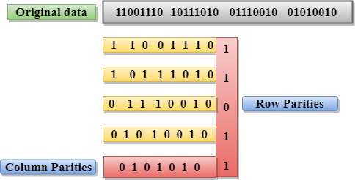
Drawbacks Of 2D Parity Check
If two bits in one data unit are corrupted and two bits exactly the same position in another data unit are also corrupted, then 2D Parity checker will not be able to detect the error.
Sometimes this technique cannot be used to detect the 4-bit errors or more in some cases.

Slide 34
Checksum
A Checksum is an error detection technique based on the concept of redundancy.
It is divided into two parts:
Checksum Generator
A Checksum is generated at the sending side. Checksum generator subdivides the data into equal segments of n bits each, and all these segments are added together by using one's complement arithmetic. The sum is complemented and appended to the original data, known as checksum field. The extended data is transmitted across the network.

Slide 35
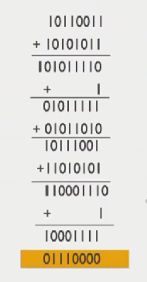
Checksum Technique Steps
At the sender node the following tasks are completed
Divide the data into equal size segment, where each segment contains m number of bits.
Suppose the following data sheet is being transferred
10110011
10101011
01011010
11010101
2. Add all the data and wrap around extra bits:
3.Complement to find the checksum
4. The original data and checksum field are sent across
the network.

Slide 36
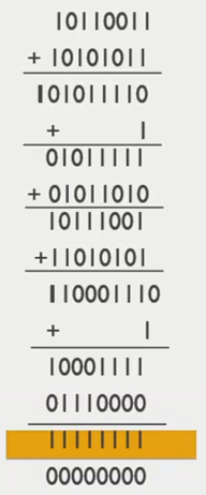
Checksum Checker
A Checksum is verified at the receiving side. The receiver subdivides the incoming data into equal segments of n bits each, and all these segments are added together, and then this sum is complemented. If the complement of the sum is zero, then the data is accepted otherwise data is rejected.
The Receiver follows the given steps:
Add all the data and wrap around same as sender’s node
Now add the received checksum the final answer
Complement it and if answer is all 0, that means data packet received successfully.

Slide 37
Cyclic Redundancy Check (CRC)
CRC is a redundancy error technique used to determine the error.
Following are the steps used in CRC for error detection:
In CRC technique, a string of n 0s is appended to the data unit, and this n number is less than the number of bits in a predetermined number, known as division which is n+1 bits.
Secondly, the newly extended data is divided by a divisor using a process is known as binary division. The remainder generated from this division is known as CRC remainder.
Thirdly, the CRC remainder replaces the appended 0s at the end of the original data. This newly generated unit is sent to the receiver.
The receiver receives the data followed by the CRC remainder. The receiver will treat this whole unit as a single unit, and it is divided by the same divisor that was used to find the CRC remainder.
If the resultant of this division is zero which means that it has no error, and the data is accepted.

Slide 38
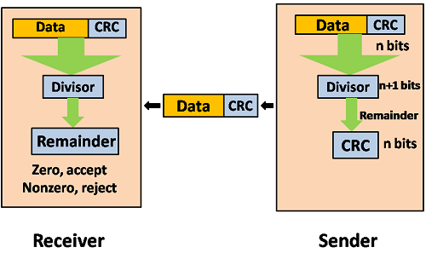

Slide 39
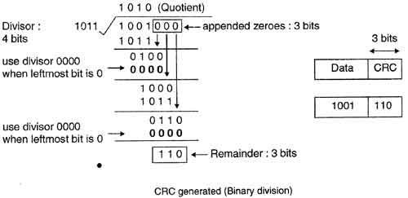
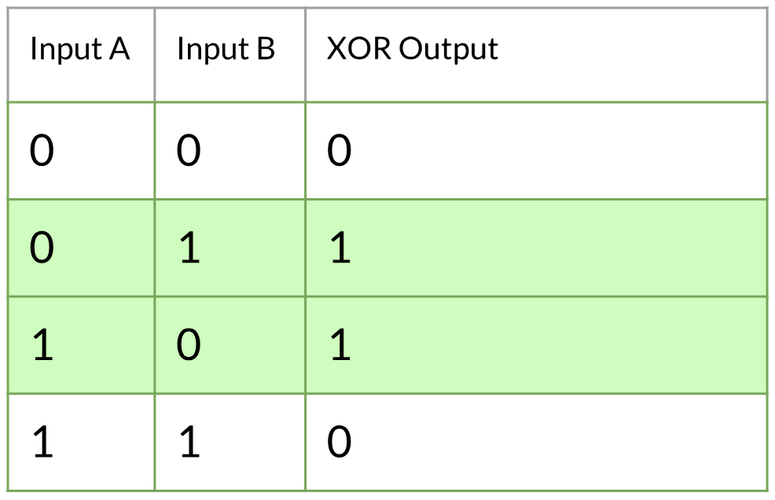

Slide 40
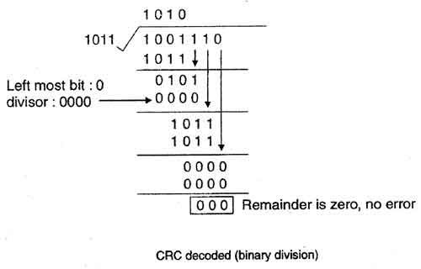

Slide 41
Error Correction
Error Correction codes are used to detect and correct the errors when data is transmitted from the sender to the receiver.
Error correction is the additional ability to reconstruct the original, error-free data.
Error Correction can be handled in two ways:
Backward error correction or ARQ: Once the error is discovered, the receiver requests the sender to retransmit the entire data unit.
Example: stop and wait AEQ, Go-back-N ARQ and selective repeat ARQ.
Forward error correction: In this case, the receiver uses the error-correcting code which automatically corrects the errors.

Slide 42
In order to correct the errors, one has to know the exact position of the error. For example, In case if we want to calculate a single-bit error, the error correction code then mainly determines which one of seven bits is in the error.
In order to achieve this, we have to add some additional redundant bits.
Suppose r (as the redundant bits) and d indicates the total number of data bits. In order to calculate the redundant bits(r), the given formula is used;
2r= d+r+1
Error correction is mainly done with the help of the Hamming code.

Slide 43
Hamming Code
To determine the position of the bit which is in error , a technique developed by R.W Hamming is Hamming code which can be applied to any length of the data unit and uses the relationship between data units and redundant units.
Steps for hamming codes:
An information of ‘m’ bits are added to the redundant bits ‘r’ to form m+r
The location of each of the (m+r) digits is assigned a decimal value.
The ‘r’ bits are placed in the position 2⁰,2¹,…..,2^{k-1} .
At the receiving end the parity bits are recalculated. The decimal value of the parity bits determine the position of an error.

Slide 44
Let us understand the concept of hamming code through an example .
Suppose the original data is 1010 which is to be sent
The number off data bits ‘m’ =4
Number of redundant bits r: 2^{r} >= m+r+1
2^{r} >= 4+r+1
2^{r}>=4+3+1
2³>=8 (satisfied)
Therefore , the value of r is 3 that satisfies the above relation
total number of bits = m+r = 4+3 =7
=>Now determining the position of the redundant bits
The redundant bits is 3. The three bits are represented by r1,r2,r4.
The position of the redundant bits is calculated with corresponds to the raised power 2. Therefore, their corresponding positions are 1, 2¹, 2².

Slide 45


The position of r1 = 1
The position of r2 = 2
The position of r4 = 4
Representation of Data on the addition of parity bits:
Determining the parity bits
R1 =1,3,5,7 =>0
R2=2,3,6,7 =>1
R4=4,5,6,7 => 0
 | r3 | r2 | r1
0 | 0 | 0 | 0
1 | 0 | 0 | 1
2 | 0 | 1 | 0
3 | 0 | 1 | 1
4 | 1 | 0 | 0
5 | 1 | 0 | 1
6 | 1 | 1 | 0
7 | 1 | 1 | 1

Slide 46
Receiver side:
Received data = 1010010
Total number bits =m+r = 7
Number of redundant bits r: 2^{r} >= m+r+1
2^{r}>=7+1
2³>=8 (satisfied)
Therefore the value of r is 3 that satisfies the above relation
The total number of data bits ‘m’ = 7-3 =4
Suppose the 4th bit is changed from 0 to 1 at the receiving end, then parity bits are recalculated .

Slide 47
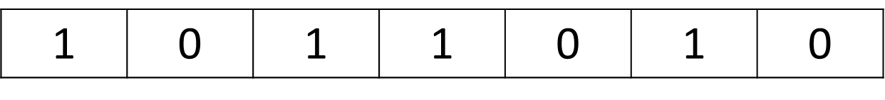
7 6 5 4 3 2 1
R1
R2
R3
1 0 0 = 4

Slide 48
Error is detected in 4th bit position. Ie
Received data =
Error bit = 4th
Corrected bit data: 1010010
Original message bit: 1010

Slide 49
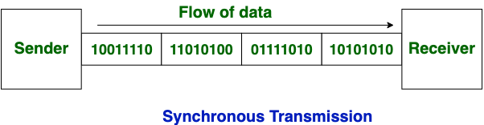
Datalink layer protocol
Synchronous transmission:
Synchronous Transmission: In Synchronous Transmission, data is sent in form of blocks or frames. This transmission is the full-duplex type. Between sender and receiver, synchronization is compulsory. In Synchronous transmission, There is no time-gap present between data. It is more efficient and more reliable than asynchronous transmission to transfer a large amount of data. It uses clock signals.
It is fast in nature.In Synchronous transmission, the time interval of transmission is constant.
The start and stop bits are not used in transmitting data
Example:
Chat Rooms
Telephonic Conversations
Video Conferencing

Slide 50
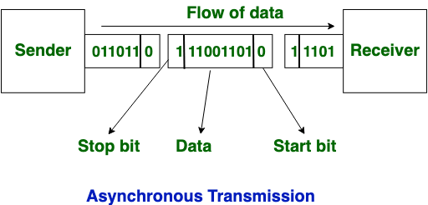
Asynchronous Transmission: In Asynchronous Transmission, data is sent in form of byte or character. This transmission is the half-duplex type transmission. In this transmission start bits and stop bits are added with data. It does not require synchronization. It does not need to use of clock signal.It does not synchronize with time. It slow in nature.
In Asynchronous transmission, the time interval of transmission is not constant, it is random.
The start and stop bits are used in transmitting data
Examples:
Email,
File transfer,
Online forms.

Slide 51

DLL Protocol: HDLC
The Synchronous Data link Control (SDLC) protocol developed by IBM is a example of bit-oriented protocol.
SDLC was later standardized by the ISO as the High-level Data Link Control Protocol in 1970s.
HDLC provides both connection oriented and connection less service.
HDLC Framing
Beginning and Ending sequence (01111110): This sequence is also transmitted during any times that the link is idle so that the sender and receiver can keep their clocks synchronized.
Header: It contains two fields ie. Address field and the control field.
Body: Payload
CRC : Error Detection field

Slide 52
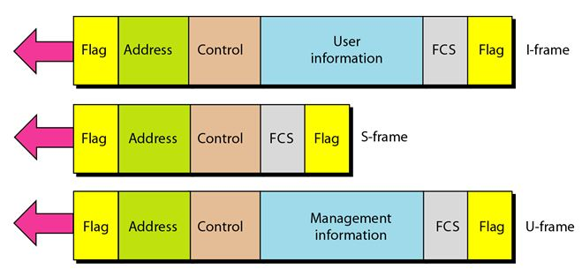
Types of Frame in HDLC:
I-frame (Information Frame)
S-frame(Supervisory frame)
U-frame(unnumbered frame)

Slide 53
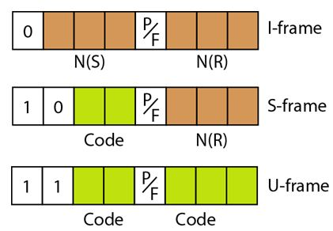
I-Frame:
I-Frames are designed to carry user data from the network
layer. In additional they can include flow and
Error control information
The first bit defines the type. If the first bit of the control
Field is 0 this means the frame is an I-frame.
The next three bits called N(S), defines the sequence number of the frame. Note that with 3 bits, we can define a sequence number between 0 to 7.
The last three bits called N(R), correspond to the acknowledgment number when piggybacking is used.
The single bit between N(S) and N(R) is called the P/F bit. The P/F field is a single bit with dual purpose. It has meaning only when it is set (bit=1) and can mean poll or final. Poll that means the frame is sent by the primary station to secondary. Final that means the frame is sent by the secondary station to primary.

Slide 54
S-Frame:
Supervisory frames are used for flow and error control whenever the piggybacking(Piggybacking is a method of attaching acknowledgment to the outgoing data packet.) is either impossible. It is used only to transport control information.
The first 2 bits of the control field is 10, this means the frame is an S-frame.
The last 3 bits, called N(R) corresponds to the acknowledgment number (ACK) or negative acknowledgement number (NAK) depending on the type of s-frame.
The 2 bits called code is used to define the type of s-frame itself . With 2 bits we can have four types of S-frame as described below.
Receive Ready(RR): If the value of the code subfield is 00, it is an RR S-Frame.This kind of frame acknowledges the receipt of a safe and sound frame or group of frames. In this case, the value of the N(R) field defines the acknowledgement number.
Receive not ready (RNR): If the value of the code subfield is 10, it is an RNR S-frame. This kind of frame is an RR frame with additional functions. It acknowledges the receipt of a frame or group of frames, and it announces that the receiver is busy or and cannot receiving more frames. It acts as a congestion-control mechanism by asking the sender to slow down. The value of N(R) is the acknowledgement number.
Reject(REJ): If the value of the code subfield is 01, It is an reject s-frame. This is a NAK frame but not like the one used for selective repeat arq. It is a NAK that can be used in Go-Back-N ARQ to improve the efficiency of the process by informing the sender, before the sender timer expires that the last frame is lost or damaged. The value of N(R) is the negative acknowledgement number.
Selective reject (SREJ): If the value of the code subfield is 11, it is an SREJ S-frame. This is a NAK frame used in Selective Repeat ARQ. Now that the HDLC protocol uses the term selective reject instead of selective repeat. The value of N(R) is the negative acknowledgment number.

Slide 55
U-Frame:
Unnumbered frame re used to exchange session management and control information between connected device. Unlike S-frame, U-frame contain an information field, but one used for system management information, not user data.

Slide 56
Point-to-point protocol:
Point-to-Point Protocol is an industry-standard data-link layer protocol for wide area network (WAN) transmission that was developed in the early 1990s. It is generally the default RAS(Remote Access Service) protocol in windows.
Point - to - Point Protocol (PPP) is a communication protocol of the data link layer that is used to transmit multiprotocol data between two directly connected (point-to-point) computers. It is a byte - oriented protocol that is widely used in broadband communications having heavy loads and high speeds. Since it is a data link layer protocol, data is transmitted in frames.
The PPP protocol is mainly used to establish a direct connection between two nodes.

Slide 57
Services provided by the PPP
Defines the format of the frame to be exchanged between devices.
PPP defines how two devices can negotiate the establishment of the link and the exchange the data.
PPP defines how the network layer data are encapsulated in the data link frame.
PPP defines hoe two devices can authenticate each other.
Providing address for network communication.
Providing connections over multiple links.
Several services are missing
PPP does not provide flow control
PPP has a very simple mechanism for error control. A CRC field is used to detect errors. If the frame is corrupted , it is silently discarded; the upper layer protocol needs to take care of the problem.
Lack of error control and sequence numbering may cause a packet to be received out of order.
PPP does not provide sophisticated addressing mechanism to handle frames in a multipoint configuration.

Slide 58
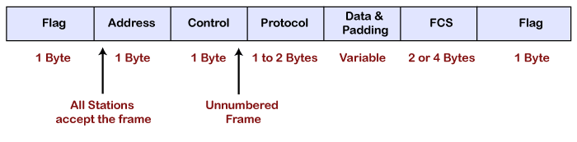
Frame format of PPP protocol
Flag: The flag field is used to indicate the start and end of the frame. The flag field is a 1-byte field that appears at the beginning and the ending of the frame. The pattern of the flag is similar to the bit pattern in HDLC, i.e., 01111110.
Address: It is a 1-byte field that contains the constant value which is 11111111. These 8 ones represent a broadcast message.

Slide 59
Control: It is a 1-byte field which is set through the constant value, i.e., 11000000. It is not a required field as PPP does not support the flow control and a very limited error control mechanism. The control field is a mandatory field where protocol supports flow and error control mechanism.
Protocol: It is a 1 or 2 bytes field that defines what is to be carried in the data field. The data can be a user data or other information.
Payload: The payload field carries either user data or other information. The maximum length of the payload field is 1500 bytes.
Checksum: It is a 16-bit field which is generally used for error detection.

Slide 60
Medida access control:
Media access control becomes important when several computers share the same communication circuit, such as a point-to-point configuration with a half-duplex configuration that requires computers to take turns, or a multipoint configuration in which several computers share the same circuit. Here, it is critical to ensure that no two computers attempt to transmit data at the same time—but if they do, there must be a way to recover from the problem. There are two fundamental approaches to media access control: controlled access and contention.
Controlled Access
Most computer networks managed by a host mainframe computer use controlled access. In this case, the mainframe controls the circuit and determines which clients can access media at what time.There are two fundamental approach to media access control:
Polling is the process of sending a signal to a client (a computer or terminal) that gives it permission to transmit or asks it to receive. With polling, the clients store all messages that need to be transmitted. Periodically, the server (usually a mainframe computer) polls the client to see if it has data to send. If the client has data to send, it does so. If the client has no data to send, it responds negatively, and the server asks another client if it has data to send.
Contention
Contention is the opposite of controlled access. Computers wait until the circuit is free (i.e., no other computers are transmitting) and then transmit whenever they have data to send. Contention is commonly used in Ethernet LANs.

Slide 61
Relative Performance
Which media access control approach is best: controlled access or contention? There is no simple answer. The key consideration is throughput—which approach will permit the most amount of user data to be transmitted through the network.
In general, contention approaches work better than controlled approaches for small networks that have low usage. In this case, each computer can transmit when necessary, without waiting for permission. Because usage is low, there is little chance of a collision. In contrast, computers in a controlled access environment must wait for permission, so even if no other computer needs to transmit, they must wait for the poll.
The reverse is true for large networks with high usage: controlled access works better. In high-volume networks, many computers want to transmit, and the probability of a collision using contention is high. Collisions are very costly in terms of throughput because they waste circuit capacity during the collision and require both computers to retransmit later. Controlled access prevents collisions and makes more efficient use of the circuit, and although response time does increase.

Slide 62
Transmission efficiency:
Transmission efficiency is defined as the total number of information bits (i.e., bits in the message sent by the user) divided by the total bits in transmission (i.e., information bits plus overhead bits). For example, let’s calculate the transmission efficiency of asynchronous transmission. Assume we are using 7-bit ASCII. We have 1 bit for parity, plus 1 start bit and 1 stop bit. Therefore, there are 7 bits of information in each letter, but the total bits per letter is 10 (7 + 3). The efficiency of the asynchronous transmission system is 7 bits of information divided by 10 total bits, or 70 percent
In other words, with asynchronous transmission, only 70 percent of the data rate is available for the user; 30 percent is used by the transmission protocol. If we have a communication circuit using a dial-up modem receiving 56 Kbps, the user sees an effective data rate (or throughput) of 39.2 Kbps. This is very inefficient.
We can improve efficiency by reducing the number of overhead bits in each message or by increasing the number of information bits. For example, if we remove the stop bits from asynchronous transmission, efficiency increases to 7/9, or 77.8 percent. The throughput of a dial-up modem at 56 Kbps would increase 43.6 Kbps, which is not great but is at least a little better.

